Slide 1
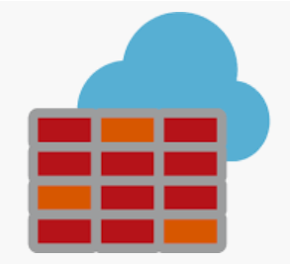
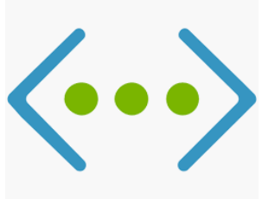
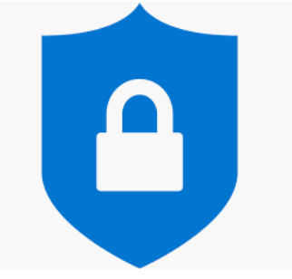
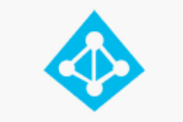
An Overview of Azure Security
How to Protect Your Data in the Cloud

Slide 2
Azure Compliance Certifications
Azure has over more then 90 compliance certifications out of which over 50 are specific to global regions.
Azure has more 35 compliance offerings specific to industries like health, government, finance, education, manufacturing and media.
ISO 20000 | CIS Benchmark | C5(Germany)
ISO 22301 | CJIS | IT- Grundschuty (Germany)
ISO 27001 | DFARS | EN 301 549 (European Union)
ISO 27017 | FIPS 140-2 | ENS (Spain)
ISO 27018 | CSA STAR Certification | PASF (UK)
ISO 9001 | WCAG 2.0 | Cyber Essentials Plus (US)

Slide 3
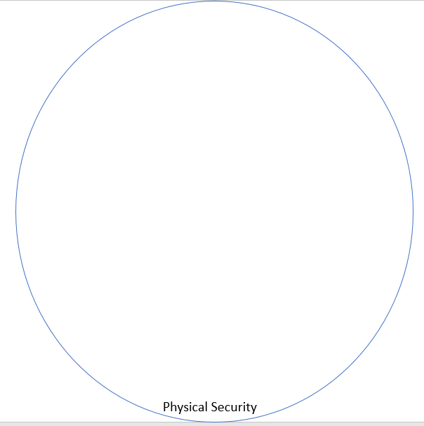
Defence in Depth – Physical Security
The Physical Security refers to the security around the Data Center.
The Data Centers are surrounded by tall fences made of steel and concrete. There are cameras around the datacenters, with a security team monitoring their videos 24/7 and 365 days of the year.
After entering the building, each personnel must pass two-factor authentication with biometrics to continue moving through the datacenter.
Tall Fences, Full-Body Metal Detection, Video Survellience, two-factor authentication including Biometrics are some of the security measures within the Data Centers.

Slide 4
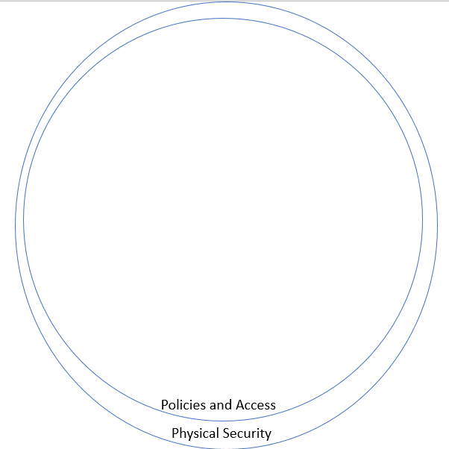
Defence in Depth – Policies And Access
The Azure Security Policies and IAM (Identity and Access Management) provides the platform to secure your data from unauthicated and unauthorized access.
Azure Security Center provides holistic view of your entire Infrastructure.
The Azure Security Center monitor your resources and provides Alerts/Warnings/Recommendations to make your Application/Data more secure.
The No Standing Access and Zero Admin Policies are methodologies of securing your Application/Data through controlled and managed access.

Slide 5
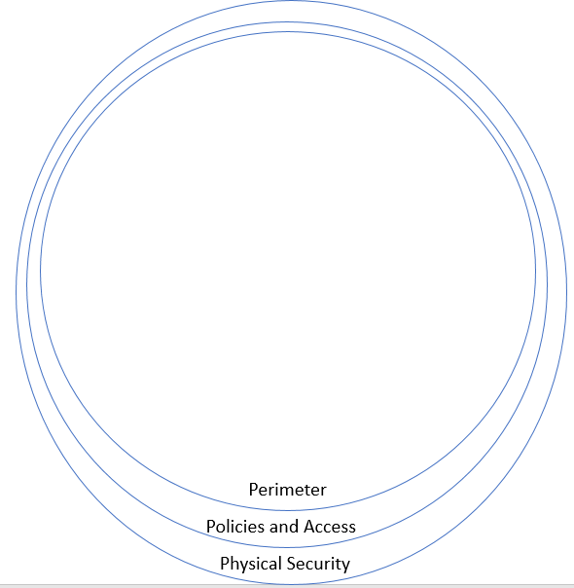
Defence in Depth – Perimeter
The perimeter refers to DDoS security.
Distributed denial of service (DDoS) attacks are some of the largest availability and security concerns facing customers that are moving their applications to the cloud.
Azure DDoS protection, combined with application design best practices, provide defense against DDoS attacks.
The Basic DDoS Plan is Free and available out of the box.
The Standard DDoS Plan Protection policies are tuned through dedicated traffic monitoring and machine learning algorithms. Policies are applied to public IP addresses associated to resources deployed in virtual networks, such as Azure Load Balancer, Azure Application Gateway, and Azure Service Fabric.

Slide 6
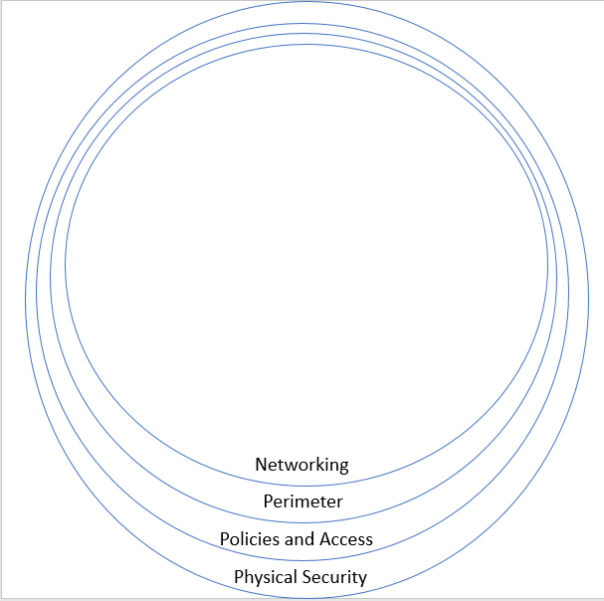
Defence in Depth – Networking
Azure Virtual Network (VNet) is the fundamental building block for your private network in Azure.
VNet is similar to a traditional network that you'd operate in your own data center, but brings with it additional benefits of Azure's infrastructure such as scale, availability, and isolation.
VNet enables many types of Azure resources, such as Azure Virtual Machines (VM), to securely communicate with each other, the internet, and on-premises networks.
There are multiple means to communicate with the On-Premise Networks from your Azure Network securely. The secured access can be setup using Point-To-Site (P2S), Site-To-Site (S2S) and ExpressRoute.

Slide 7
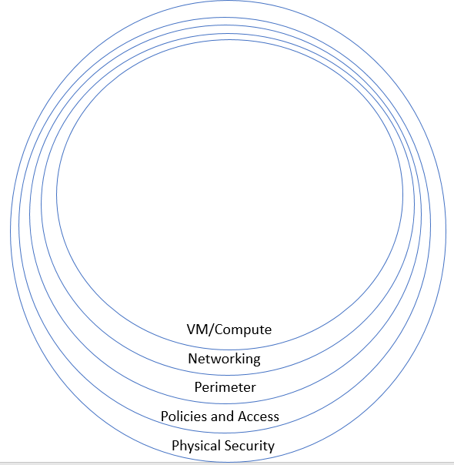
Defence in Depth – VM/Compute
The access to the Virtual Machines needs to be secured.
This can be done by implementing JIT (Just In Time Access) which provides access to specific IP for a specific duration.
This enables Users to access Virtual Machine for troubleshooting purposes.
The data disks used by the Virtual Machines needs to be Encrypted.
The Bastion service is a PaaS offering that enables you to securing connect over RDP/SSH to your Virtual Machines from the Azure Portal.

Slide 8
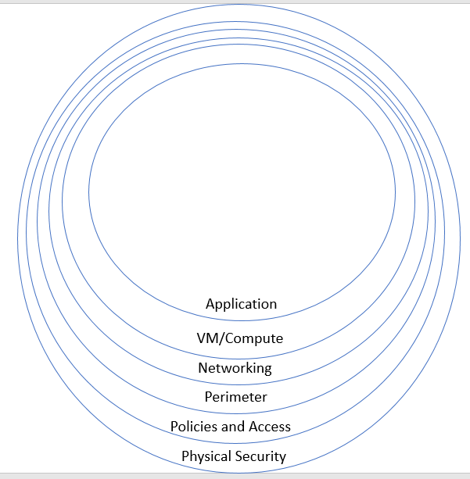
Defence in Depth – Application
The applications can be secured using SSL Certificates or Client Certificates.
Integration with Azure Active Directory enables setting up a secured Authentication access to your Applications.
The Azure Services like Application Gateway provides a secured layer around your application.
Azure Application Gateway has WAF (Web Application Firewall) built in by default to secure your Internet Facing Applications.
Web application firewall (WAF) is a service that provides centralized protection of your web applications from common exploits and vulnerabilities.

Slide 9
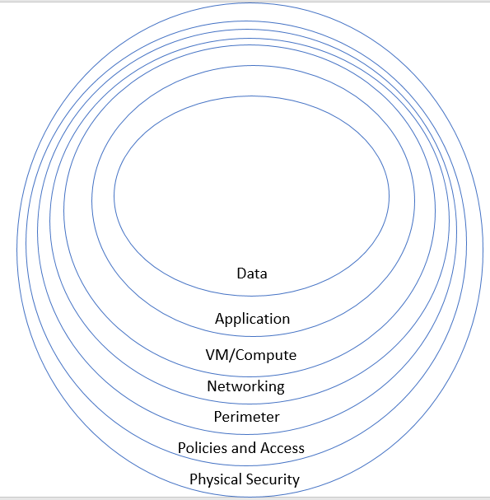
Defence in Depth – Data
The core around which all of the of Security is setup is Data.
This can be Customer Data, Employee Data, Financial Data, Audit Data etc.,.
Data needs to be secured both at rest and in transit.
There are means for securing your data at rest. The primary option is Encryption. Microsoft Encrypts data in rest by default.
Organizations can further secure it using BYOK specifically for Azure SQL PaaS.
Data can be secured using other means like Data Masking etc., as well.

Slide 10
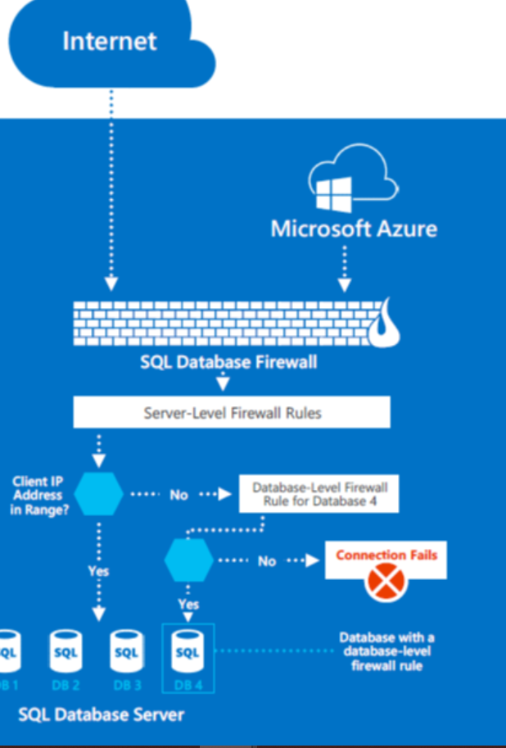
Azure SQL PaaS Security
The Azure SQL PaaS is publicly available but it is not publicly accessible.
There are layers of Firewall Rules setup to secure your data. These Firewall Rules are available Out-Of-The-Box.
The first layer of security is your Database Firewall which specifies which Ips/Ranges can access the SQL DB Instance.
The second layer of security is your Server Level Firewall which specifies which Ips/Ranges can access the SQL Server Instance.
To secure your data and for to maange it the ideal means is to leverage Virtual Networks.

Slide 11
Defence in Depth
The core of Security is Data.
This can be Customer Data, Employee Data, Financial Data, Medical Data, Audit Data etc.,.
Data can be data in a Data Store, data exposed through API, data visible through Web Site etc.,.
Data

Slide 12
Defence in Depth - Physical Security
The Physical Security refers to the security around the Data Center.
There are more than 100 Data Centers across more than 50 regions.
Tall Fences, Full-Body Metal Detection, Video Survellience, two-factor authentication including Biometrics are some of the security measures within the Data Centers.
Physical Security
Notes:
1. The initial layer is the controlling of personnel requests for Data Center access.
2. The next layer is the building‘s perimeter. The Data Centers are surrounded by tall fences made of steel and concrete. There are cameras around the datacenters, with a security team monitoring their videos 24/7 and 365 days of the year.
3. After entering the building, each personnel must pass two-factor authentication with biometrics to continue moving through the datacenter. If the identity is validated, then they can enter the portion of the datacenter that they have approved access to and can stay there only for the duration of the time approved.
4. Once they arrive at the entrance to the requested part of the datacenter floor, they must pass a full body metal detection screening. To reduce the risk of unauthorized data entering or leaving the datacenter without our knowledge, only approved devices can make their way into the datacenter floor.
5. Additionally, video cameras monitor the front and back of every virtual machine rack.
6. The ull body metal detection screening is repeated when you exit the datacenter floor. To leave the datacenter, you have to pass through an additional security scan.

Slide 13
Defence in Depth – Data
The core of Security is Data.
This can be Customer Data, Employee Data, Financial Data, Audit Data etc.,.
The various means of securing Data are Encryption (at rest and in transit), data masking.
Data
Data
Application
VM/Compute
Networking
Perimeter
Policies and Access
Physical Security

Slide 14
Defence in Depth – Application
The applications can be secured using SSL Certificates or Client Certificates.
The Azure Services like Application Gateways provides a secured layer around your application.
Integration with Azure Active Directory secures the access to your Applications.
Application
VM/Compute
Networking
Perimeter
Policies and Access
Physical Security

Slide 15
Defence in Depth – VM/Compute
JIT Access, Disk Encryption, are some of the means of securing your Virtual Machine(s).
The Bastion Service enables secured access to your Virtual Machine directly from the Azure Portal.
VM/Compute
Networking
Perimeter
Policies and Access
Physical Security

Slide 16
Defence in Depth - Networking
Virtual Networks and Subnets create a Logical bubble to secure your application and data.
Access to and from applications within Virtual Networks/Subnets can be controlled using Network Security Rules.
Firewall Rules can control access to secure access to your PaaS Services as well like SQL Databases, Functions and Storage etc.,.
Networking
Perimeter
Policies and Access
Physical Security

Slide 17
Defence in Depth – Perimeter
This Layer secures your data/application from DDoS attacks.
The Basic DDoS Plan is Free and available out of the box.
The Standard DDoS provides additional security with respect to Volumetric attacks and Protocol attacks.
Perimeter
Policies and Access
Physical Security

Slide 18
Defence in Depth – Policies And Access
The Azure Security Policies and IAM (Identity and Access Management) provides the platform to secure your data from unauthicated and unauthorized access.
Azure Security Center provides holistic view of your entire Infrastructure.
The No Standing Access and Zero Admin Policies are means of securing access to your Azure Infrastructure.
Policies and Access
Physical Security

Slide 19
Defence in Depth - Physical Security
The Physical Security refers to the security around the Data Center.
There are more than 100 Data Centers across more than 50 regions.
Tall Fences, Full-Body Metal Detection, Video Survellience, two-factor authentication including Biometrics are some of the security measures within the Data Centers.
Physical Security
Notes:
1. The initial layer is the controlling of personnel requests for Data Center access.
2. The next layer is the building‘s perimeter. The Data Centers are surrounded by tall fences made of steel and concrete. There are cameras around the datacenters, with a security team monitoring their videos 24/7 and 365 days of the year.
3. After entering the building, each personnel must pass two-factor authentication with biometrics to continue moving through the datacenter. If the identity is validated, then they can enter the portion of the datacenter that they have approved access to and can stay there only for the duration of the time approved.
4. Once they arrive at the entrance to the requested part of the datacenter floor, they must pass a full body metal detection screening. To reduce the risk of unauthorized data entering or leaving the datacenter without our knowledge, only approved devices can make their way into the datacenter floor.
5. Additionally, video cameras monitor the front and back of every virtual machine rack.
6. The ull body metal detection screening is repeated when you exit the datacenter floor. To leave the datacenter, you have to pass through an additional security scan.

